Slide 1
Retail Sales Volumes Forecasting
and
Pricing Strategy Recommendations
Xiaoyan Zhou
12/07/2018

Slide 2
CONTENTS
Sales volumes Forecast
1
Impact of Pricing on Sales Volume
2
Recommendation on Pricing Strategy
3

Slide 3
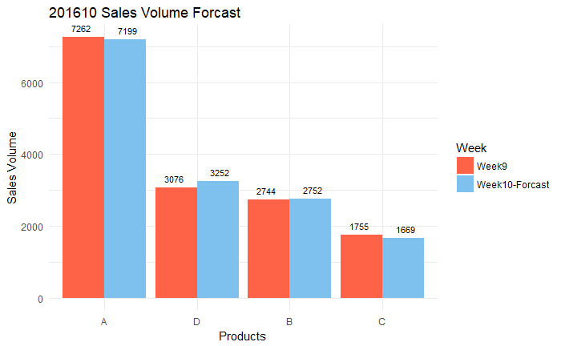
Sales volumes Forecast
1
Sales volumes in 1 week- Using random forest
The sales volume of product B will increase by 5.72%, while the sales volume of product D will decrease by 4.9%.
The sales volumes of product A and product C will basically remain unchanged in week 201610.
* Product A are all products in Group 26387251, Product B are all products in Group bca94c97, Product C is all products in Group edf80f3a, Product D is all products in Group 606565a1

Slide 4
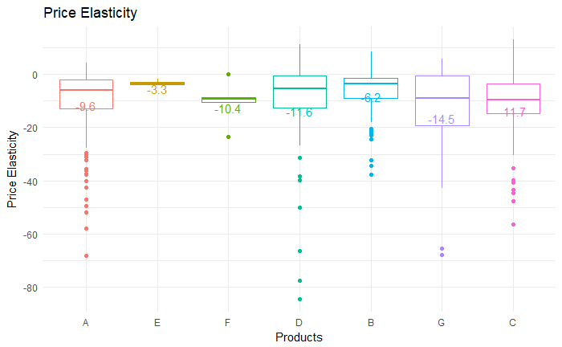
Impact of Pricing on Sales Volume
2
The price elasticity evaluates the percentage change of sales volumes when product price the product price change by 1 percentage.
All groups of products in the given price change dataset are with a negative price elasticity, which means reducing price will lead to a higher sales volumes.
The absolute value of all products group are larger than 1, which means all products are very price sensitive.

Slide 5
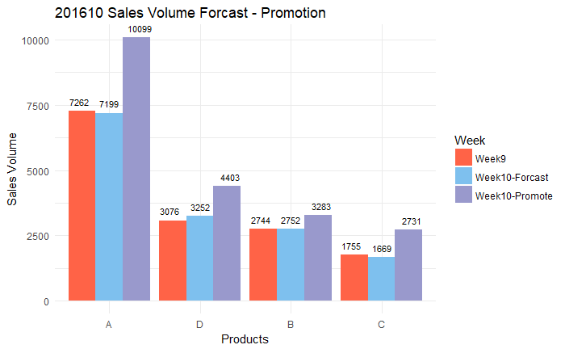
2
Impact of Pricing on Sales Volume
Applying 1 pound promotion to all products can boost sales volume effectively.
The sales volume percentage of product C is expected to increase mostly( 55.61%), and C is very price sensitive.
The increased sales volume of product A is predicted to be largest.

Slide 6
Recommendation on Pricing Strategy
3
Recommendation:
To boost next week’s sales volume, price reduce promotions can be apply to product A and product C.
The price of product B and D can remains unchanged as it will have natural increase even without the promotion.
Expected result:
The total sales volume will increased by 26.33% instead of 0.24%, compared to week 9.

Slide 7
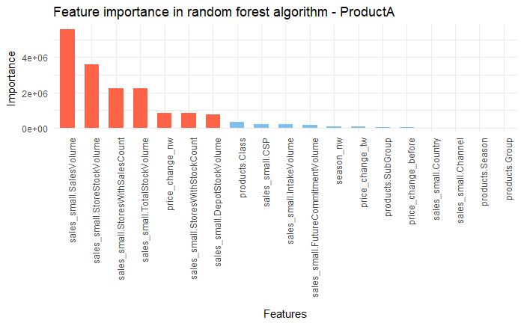
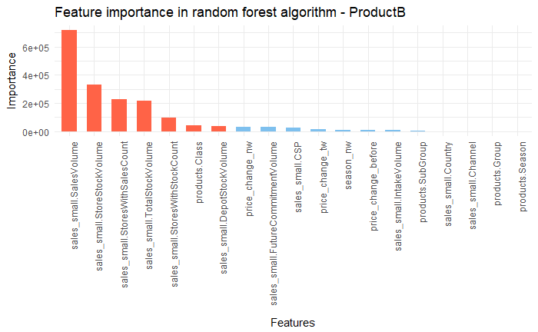
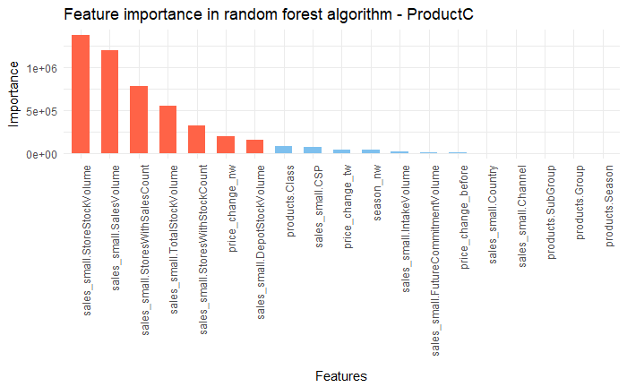
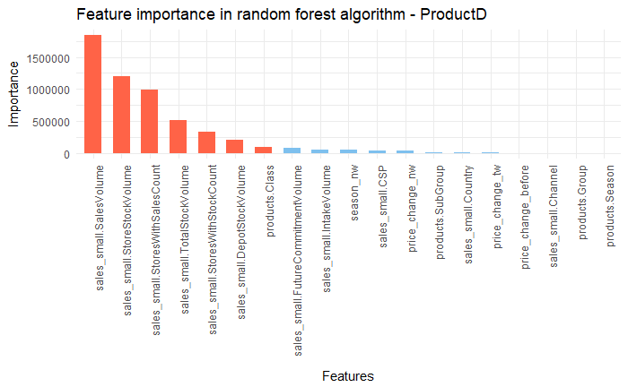
Recommendation on Pricing Strategy
3
Insight:
For all four products, stores stocks volumes, stores with sales count, total stocks volume, stores with stocks counts are also very important in predicting sales
Recommendation:
When providing sales promotion, it is important to keep stocks in a adequate level to meet the need of customers

